Slide 1
Dinosaur Taxa Classification
By Edward Torres, Cameron Wilson, Mitchell Knight, and Erik Pena

Slide 2
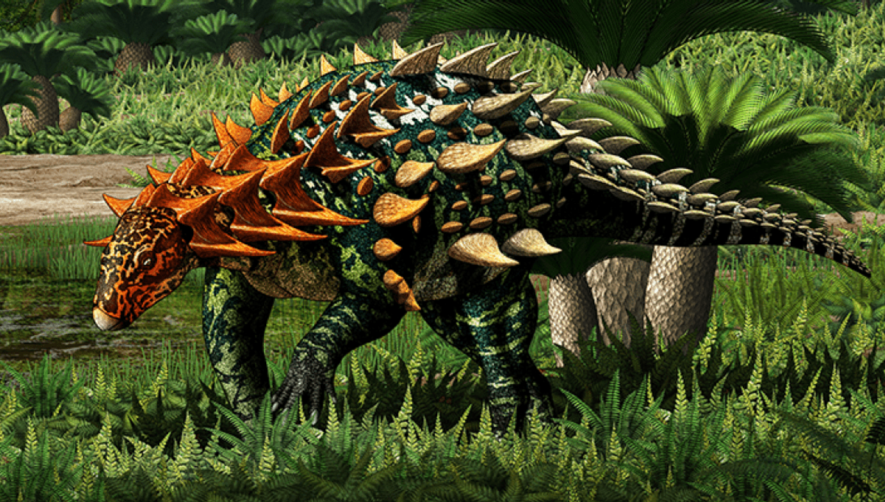
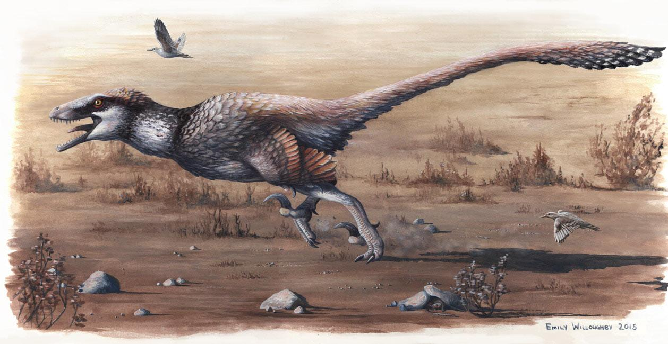
The Purpose
To use a Paleobiology Database to create a machine learning model that would be capable of classifying which Taxonomic group a fossil may belong to based on the geographic and geological data of the site a specimen was found at. This model would be intended to assist researchers with making better predictions on types of unidentified fossils. Allowing them to narrow the range of possible groups a fossil may belong to if other observable data is absent.

Slide 3
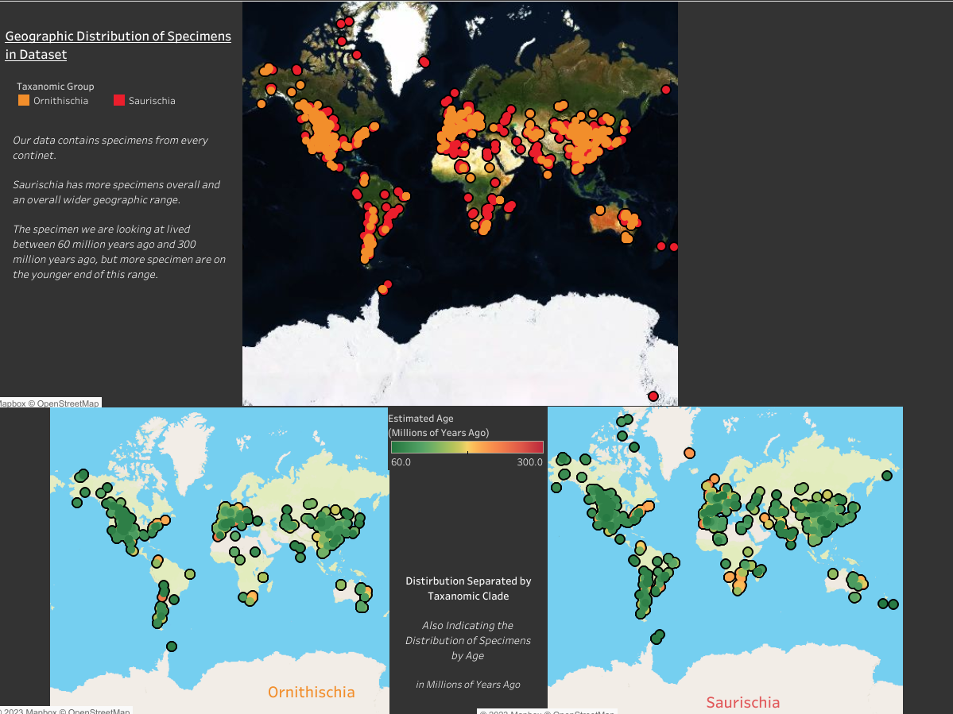
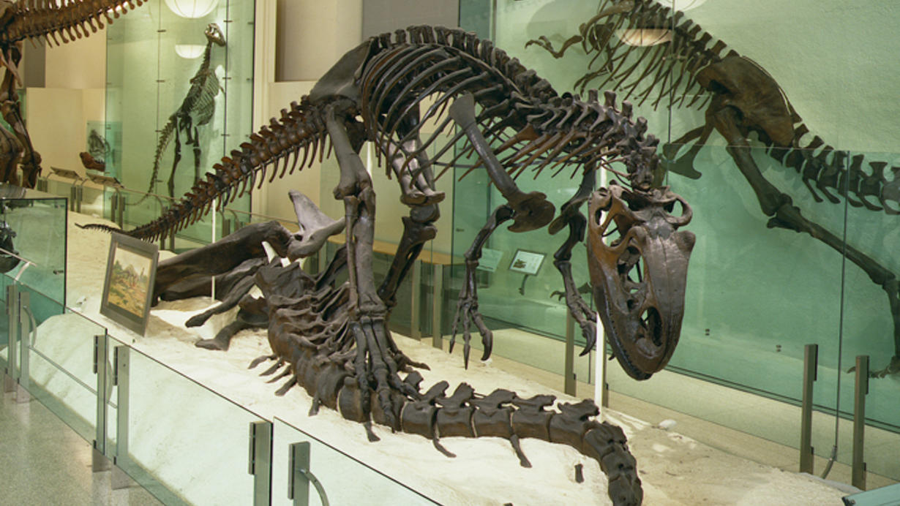
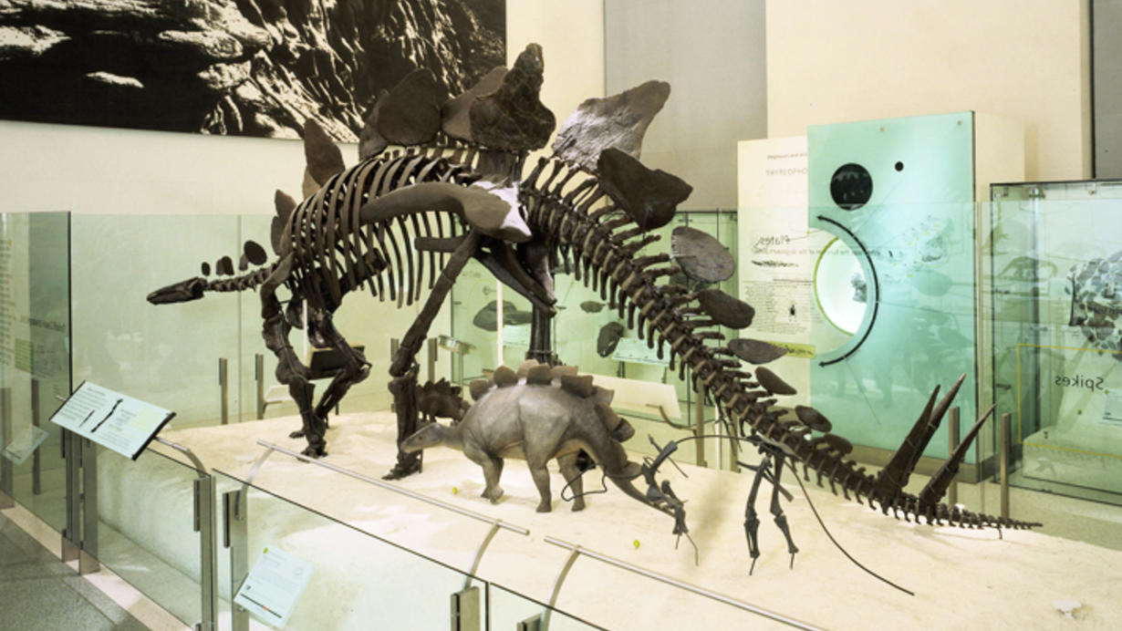
Visualizing our Data

Slide 4
Our Variables
Geographic Coordinates (Latitude, Longitude) of where a specimen was found
Lithology of the sedimentary layer the fossil was found in
(Sandstone, slate, etc.)
Estimated age of the sedimentary layer in Millions of Years Ago and the corresponding geologic time period
Paleoenvironment of the sedimentary layer
(terrestrial, aquatic, marine, riverbed, lake, etc)

Slide 5
Machine Learning
Building a binary classification model
Predicting taxonomic group
0- Ornithischia or 1- Saurischia
Multiple input dimensions with categorical columns
Needed to encode these columns
Tried OneHotEncoder and LabelEncoder
Found LabelEncoder to be better optimized
Tried multiple models
Logistic Regression
Decision Tree
Neural Network
Notes:
Let;s discuss what exactly we want the model to predict.

Slide 6
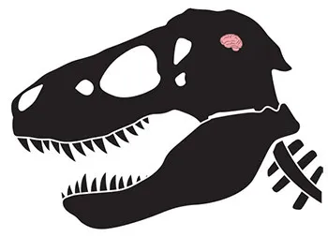
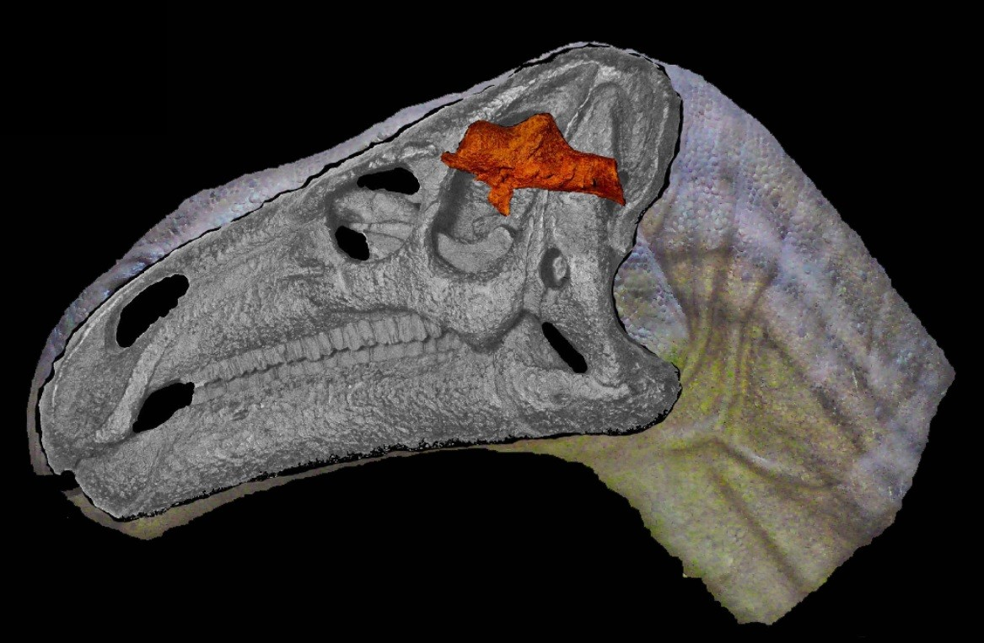
Neural Network
The primary model we developed was a neural network
Allowed for deeper optimization and testing
Variations of the model included changes to:
Dataset
Hidden Layers
Neuron counts
Activation function
Epochs
Optimizers
Achieved an accuracy of greater than 75% on model version 13

Slide 7
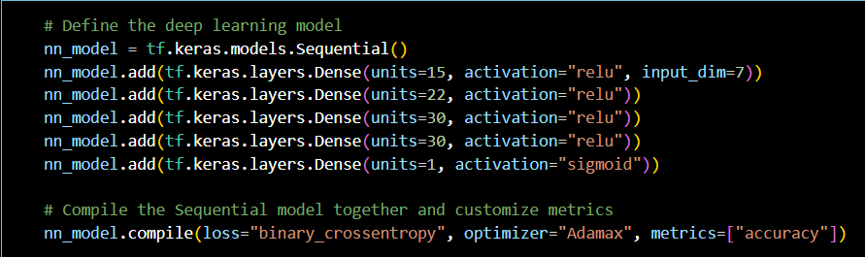
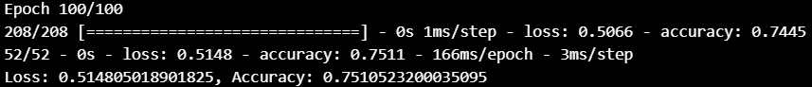
The Final Model

Slide 8
The Process

Slide 9
Data Clean Up
Metadata and Null Values
Regex library was used to sort out inconsistencies
Parentheses
Quotations
Forward slashes
Rebalancing our data:
Pivoted to another pair of genera

Slide 10
Encoding Comparison
Label Encoder
Non binary
0 to n_class -1
MLs require text features be converted to numeric values
OneHot Encoder
Binary
Each feature becomes a column

Slide 11
Logistic Regression
Logistic Regression is based on Binary variable datasets.
The main issue with this model was in its ability to learn from an imbalanced dataset.
This model would best be used with a more balanced dataset unlike ours

Slide 12

Decision Tree
Minimal data preparation
Easily sorts non numeric features
Genus
Lithology
Environment
Quickly neared 75% accuracy
Notes:
Scaled numerics and converted strings to columns,
These series comprised the majority of the models data
In my case i only included lng which increased accuracy

Slide 13
History of our Dataset
Our original dataset was looking at North American specimens of the Clades Theropoda and Thyreophora. These are the groups that include species such as the Tyrannosaurus and Stegosaurus respectively.
This dataset was much smaller and when we applied it to a logistic regression model we had an accuracy of over 85% immediately. However, the model accomplished this by simply always guessing Theropoda because the dataset was so imbalance.

Slide 14
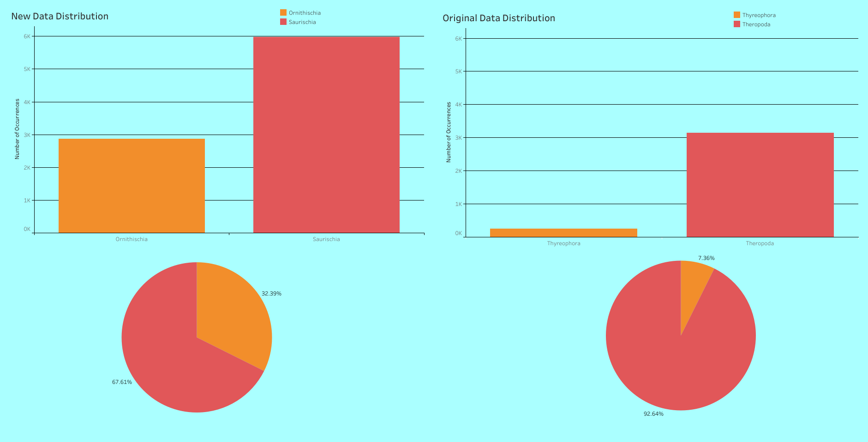

Slide 15
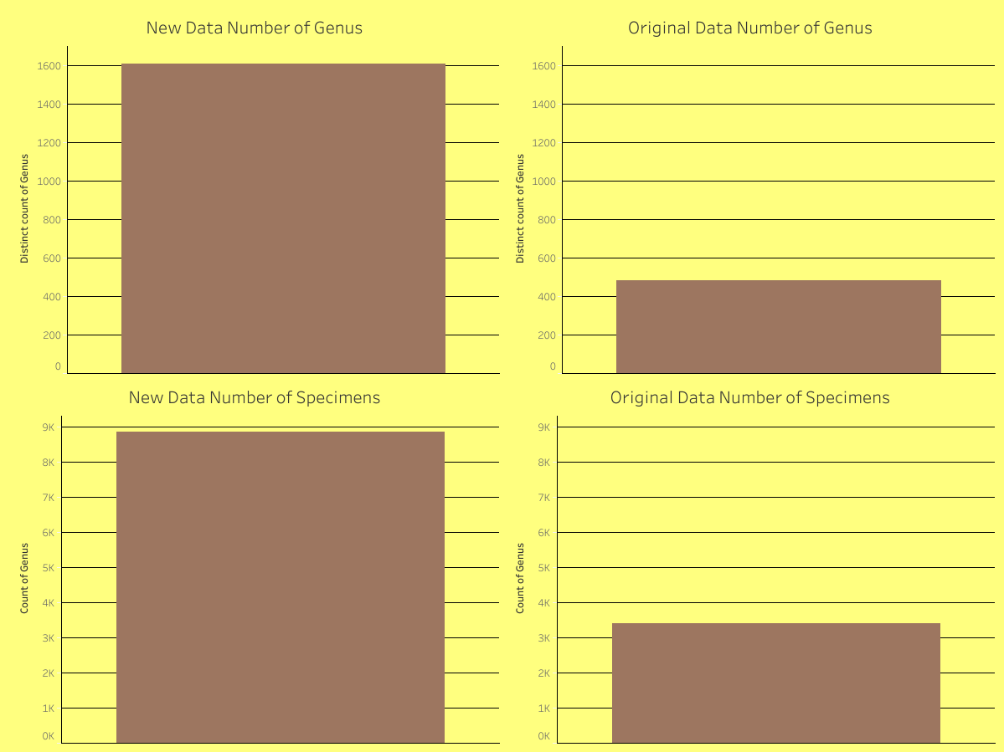
Before and After
Our new dataset expands the geographic range of the data, narrowed the age range of the specimens, and looked at higher taxonomic levels in inject more specimens and better balance the dataset overall.

Slide 16
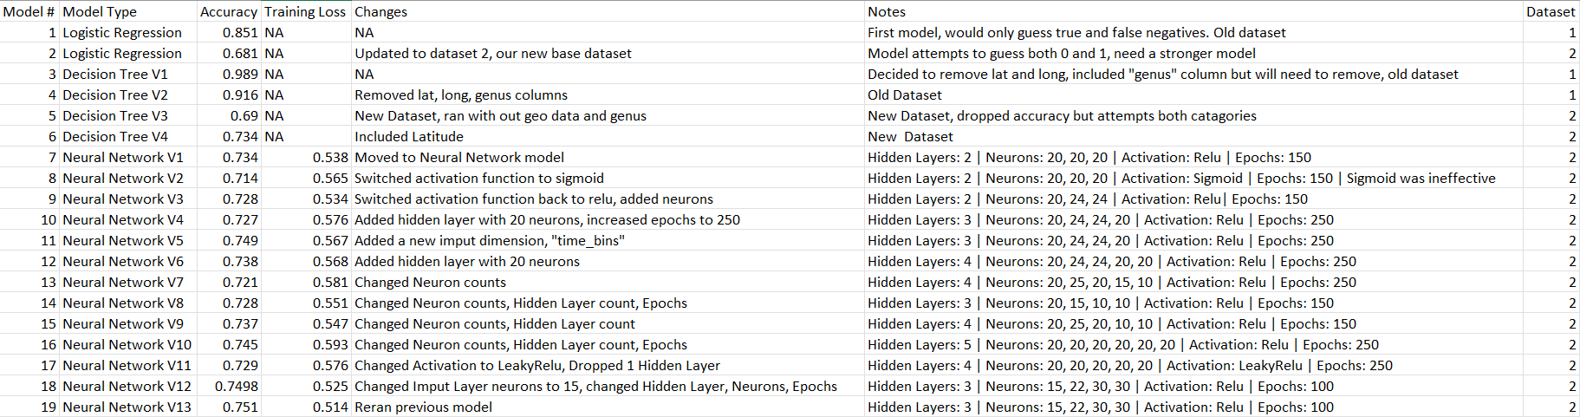

Slide 17
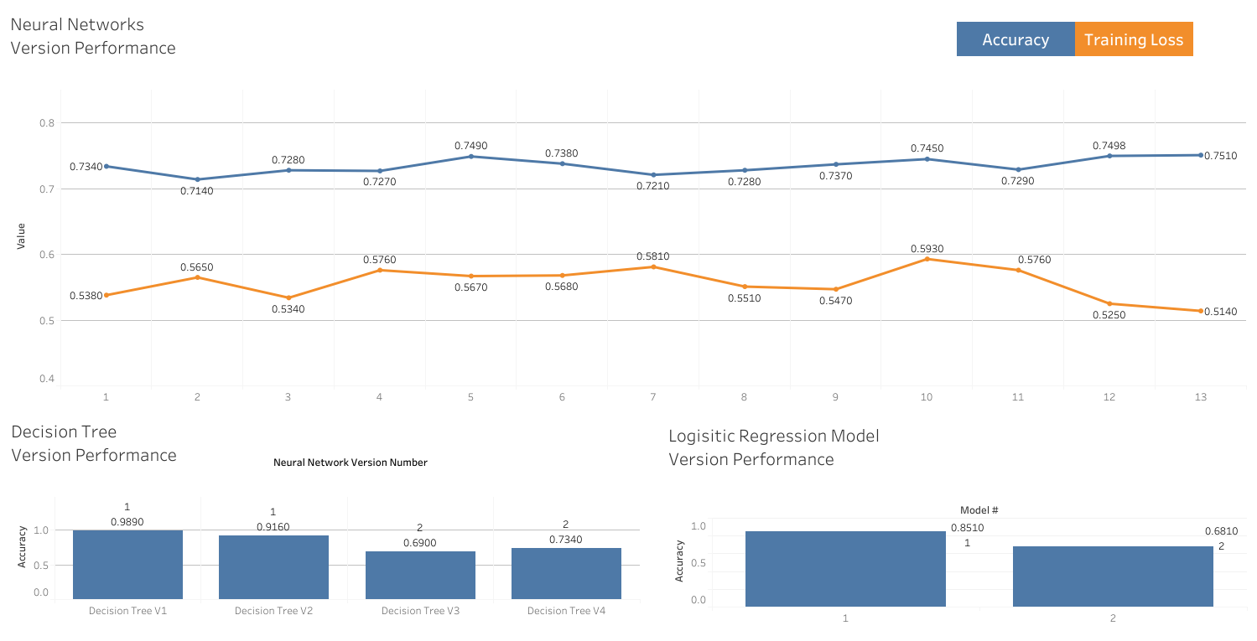
Model History and Performance

Slide 18
Conclusion
As the model is now it may still have some value to our target demographic as an avenue to engage in an initial assessment of an unidentified fossil specimen to develop theories or determine how an investigation should proceed. However the model is not definitive so it should not be used as a source to defend the classification of a fossil.

Slide 19
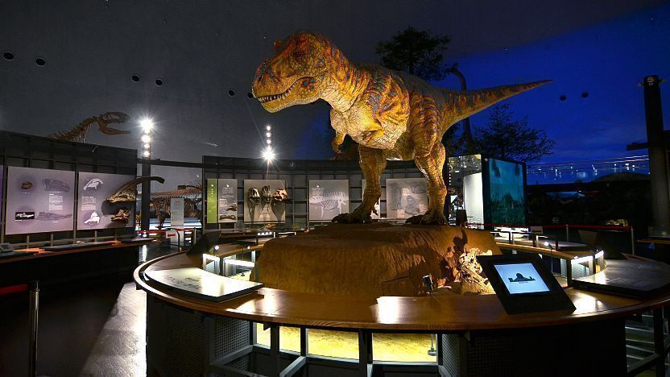
Retrospective and Improvements
Other considerations:
Finding and injecting more usable variables into the model to see if the addition improves the model
Trying an algorithm to re-position geographic coordinates from their modern placement to where they would have been based on the estimated age adjusting for tectonic drift
Limitation:
Data involving the measurements of fossils did not have proper join parameters with our other data, the dataset was smaller and far more incomplete with fewer specimens, not many full skeletons of specimens and not multiple complete skeletons of the same species which would limit the model in identifying patterns.

Slide 20
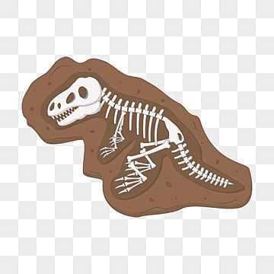
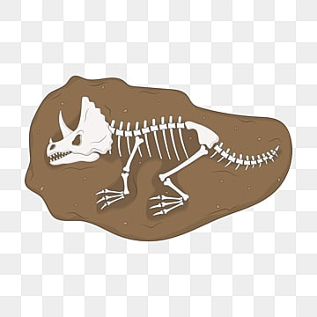
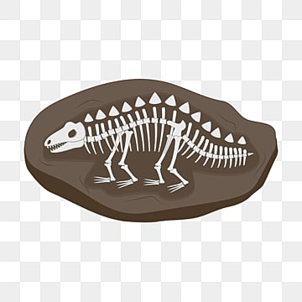
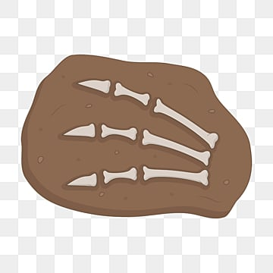
Sources
Data
The Paleobiology Database. (n.d.). https://paleobiodb.org/#/
Images in Presentation
Allosaurus fossil cast. American Museum of Natural History. (n.d.). https://www.amnh.org/exhibitions/permanent/saurischian-dinosaurs/allosaurus
Dinosaur museum. Fukui Prefectural Dinosaur Museum - Fukui Travel. (n.d.). https://www.japan-guide.com/e/e6602.html
Earth Touch News Jon Tennant. (2015, November 3). Move over velociraptor, there’s a bigger, Badder Raptor in Town! Earth Touch News Network. https://www.earthtouchnews.com/discoveries/fossils/move-over-velociraptor-theres-a-bigger-badder-raptor-in-town/
Funnell, R. (2022, July 27). Earliest armored dinosaur from Asia discovered, and it’s a hella punk. IFLScience. https://www.iflscience.com/earliest-armored-dinosaur-from-asia-discovered-and-its-a-hella-punk-62965
Stegosaurus fossil skeleton. American Museum of Natural History. (n.d.-b). https://www.amnh.org/exhibitions/permanent/ornithischian-dinosaurs/stegosaurus
NicoleJiang. (n.d.). Fossil clipart images: Free download: PNG transparent background. Pngtree. https://pngtree.com/so/fossil-clipart
Fall Tree Clipart. OpenClipart https://creazilla.com/nodes/20843-fall-tree-clipart

